Slide 1


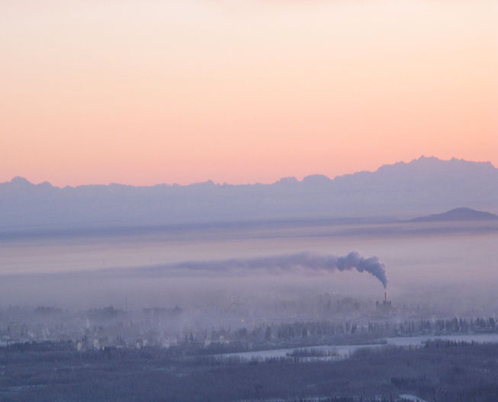
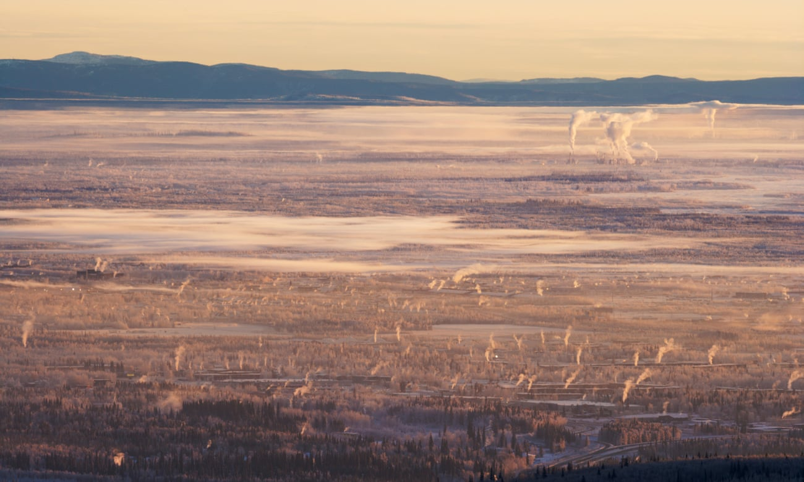

Predicted impacts of heterogeneous chemical pathways on particulate sulfur in Fairbanks, Alaska
Sara Farrell^{1,2,3}, Havala O. T. Pye³, Robert Gilliam³, George Pouliot³, Deanna Huff⁴, Golam Sarwar³, William Vizuete², Kathleen Fahey³
1. Oak Ridge Institute for Science and Engineering 2. Gillings School of Global Public Health at UNC-Chapel Hill 3. Office of Research and Development at the USEPA 4. Alaska Department of Environmental Conservation
The views expressed in this presentation are those of the author and do not necessarily reflect the views or policies of the U.S. EPA
Notes:
Good Afternoon. My name is Sara Farrell and I am both a Ph.D. student at UNC-Chapel Hill and an ORISE Researcher at the EPA and the work I will be presenting on today done under the mentorship of Dr. Kathleen Fahey at the EPA. And for the past year and a half, myself and my co-authors have been trying to better understand the role that heterogeneous sulfur aerosol formation plays during wintertime haze events in Fairbanks, Alaska. I should also mention that the view expressed in this presentation are those of the authors and don’t necessarily reflect the views or polices of the USEPA.

Slide 2

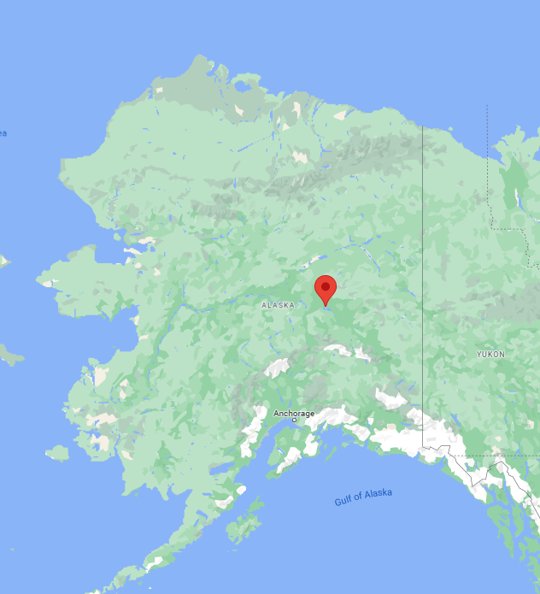
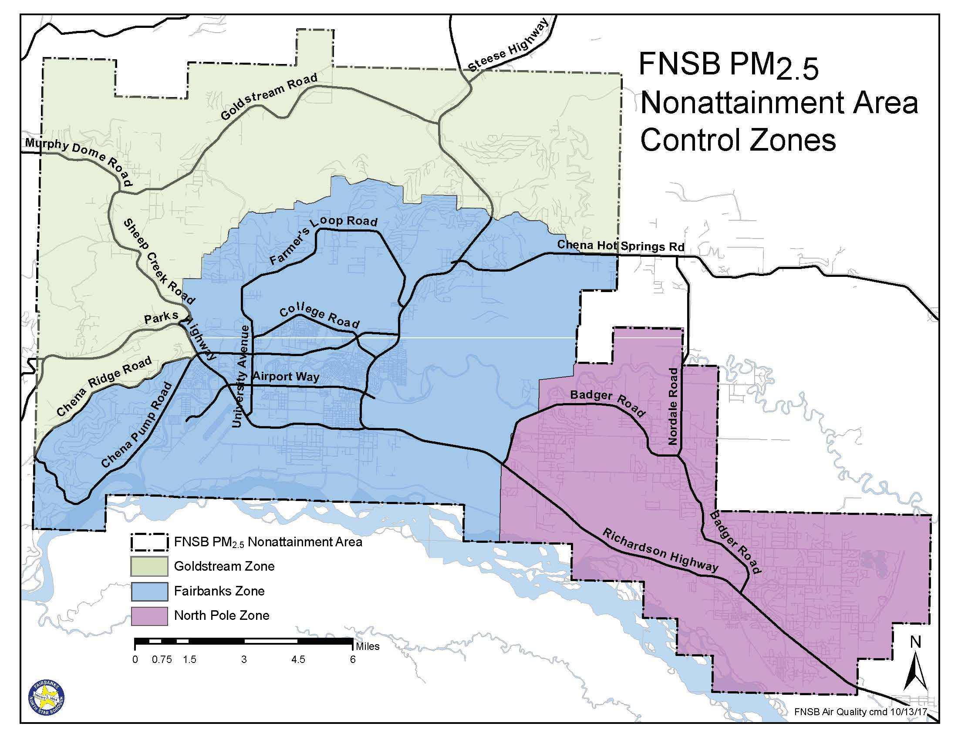
Motivation and Significance
1
Fairbanks and North Pole, (cities in Alaska), have exceeded fine particulate matter (PM_{2.5}) NAAQS for many years in the past decade
These exceedances have been linked to increased incidence of cardio-cerebral and respiratory hospitalizations (Mclaughlin and Castrodale, 2010)
Alaska DEC, 2017
Mclaughlin and Castrodale, 2010
Notes:
One of the reasons I am presenting in this session is because Fairbanks and North Pole are in non-attainment, or exceeded their national ambient air quality standards (or NAAQS) for fine particulate matter (PM2.5). When I say North Pole, I’m not talking about the north pole. North Pole Alaska is actually a city southeast of Fairbanks.
PM2.5 is a regulated by the EPA because it has just the right angular momentum to deposit deep within lung tissue and elevated concentrations of PM2.5 have been linked to increased negative health outcomes around the world and also specific to this area.

Slide 3
CMAQ Underestimates Sulfate during an Alaskan PM_{2.5} Event
2
Extremely Cold Temperatures (~-30 C to -40 C)
Increased Heating Stove Use
  Increased Emissions
Temperature Inversions
  Low Planetary Boundary Height
Notes:
Wintertime in Alaska, as you can imagine, is very cold (getting down to the negative 40’s Celsius. Given these extreme temperatures, a lot of households keep warm using home heating stoves and the colder it is, the more fuel is being combusted and emitted via chimneys. As noted in Rob Gilliams presentation yesterday, this area is also surrounded by mountains and decreased surface temperatures also drive temperature inversions leading to a lower planetary boundary height. The increase in particle mass from heating emissions mixing in a smaller container from the lower PBL height gives way to

Slide 4
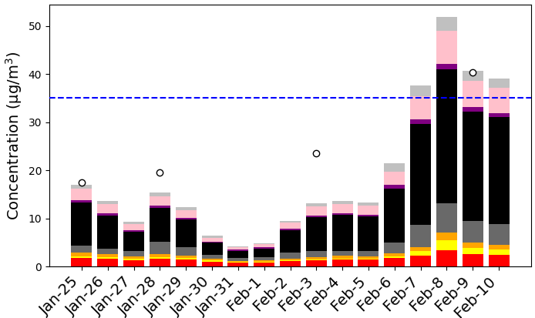
CMAQ Underestimates Sulfate during an Alaskan PM_{2.5} Event
2
Modeled and Observed PM_{2.5} Concentrations Winter 2008
Extremely Cold Temperatures (~-30 C to -40 C)
Increased Heating Stove Use
  Increased Emissions
Temperature Inversions
  Low Planetary Boundary Height
SO4
NO3
NH4
EC
OC
Metals and Ions
NCOM
Other
Notes:
winter-time haze events. What I have plotted here are daily averaged PM2.5 concentrations, broken out by pm2.5 species, at a grid cell in downtown Fairbanks for a historical wintertime episode in 2008 along with observed PM2.5 concentrations at this site represented by the circles. You can see that from Feb 7th – the 10th that PM2.5 concentrations exceed the 24-hour NAAQS represented by the blue dashed line.

Slide 5
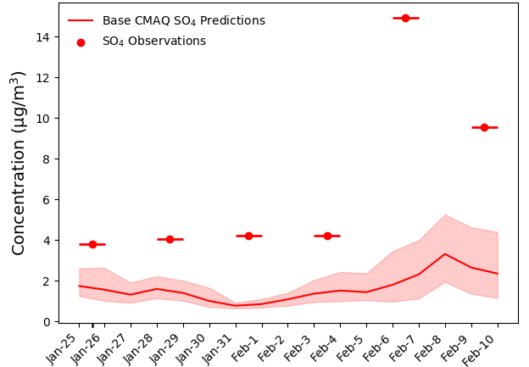
CMAQ Underestimates Sulfate during an Alaskan PM_{2.5} Event
2
Modeled and Observed PM_{2.5} Concentrations Winter 2008
Extremely Cold Temperatures (~-30 C to -40 C)
Increased Heating Stove Use
  Increased Emissions
Temperature Inversions
  Low Planetary Boundary Height
SO4
NO3
NH4
EC
OC
Metals and Ions
NCOM
Other
Notes:
The focus of this presentation is on the fraction of PM2.5 that is sulfate – given it’s importance in regulating aerosol pH and secondary organic aerosol formation.
Similarly in this plot I am showing CMAQ model output for sulfate with the line representing daily average modeled concentrations and the shading representing daily min and max modeled sulfate concentrations and observations as the cross-haired circles

Slide 6
CMAQ Underestimates Sulfate during an Alaskan PM_{2.5} Event
2
Modeled and Observed PM_{2.5} Concentrations Winter 2008
Extremely Cold Temperatures (~-30 C to -40 C)
Increased Heating Stove Use
  Increased Emissions
Temperature Inversions
  Low Planetary Boundary Height
While PM_{2.5} concentrations are reasonably predicted
SO4
NO3
NH4
EC
OC
Metals and Ions
NCOM
Other
Notes:
And while CMAQ models PM2.5 for this episode fairly well

Slide 7
CMAQ Underestimates Sulfate during an Alaskan PM_{2.5} Event
2
Modeled and Observed PM_{2.5} Concentrations Winter 2008
Extremely Cold Temperatures (~-30 C to -40 C)
Increased Heating Stove Use
  Increased Emissions
Temperature Inversions
  Low Planetary Boundary Height
While PM_{2.5} concentrations are reasonably predicted
CMAQ underpredicts wintertime Alaskan Sulfate Concentrations
SO4
NO3
NH4
EC
OC
Metals and Ions
NCOM
Other
Notes:
It underpredicts observed sulfate concentrations, especially during a PM2.5 exceedance event.

Slide 8
Why is there such disagreement in SO₄ Concentrations???
3
Notes:
So why is there such model-measurement disagreement with sulfate here?

Slide 9
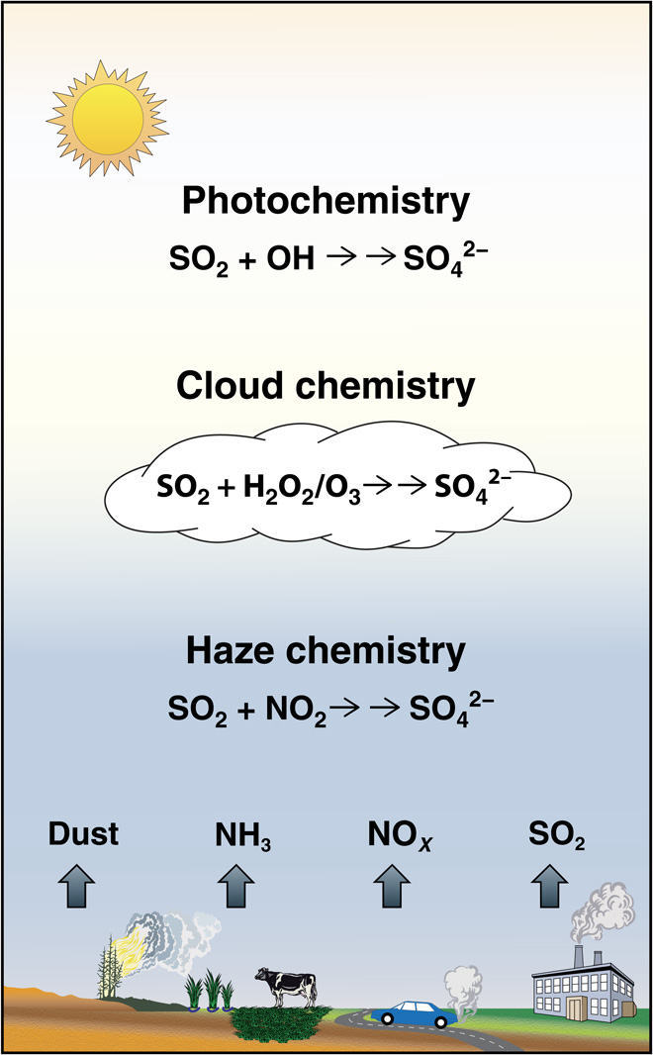
Why is there such disagreement in SO₄ Concentrations???
3
1) Missing aerosol-phase sulfur chemistry in CMAQ
Primary SO₄ from emissions
Secondary SO₄ from:
  Gas-phase oxidation
  In-cloud aqueous oxidation
/etc.
figure modified from Cheng et al., 2016
Notes:
1 reason is that there is missing aerosol-phase sulfur chemistry in CMAQ. CMAQ currently accounts for primary, or directly emitted sulfate via emissions files and then secondarily formed sulfate from sulfur dioxide emissions can be made in the model via gas-phase oxidation by hydroxyl radicals and via in-cloud aqueous oxidation by hydrogen peroxide, ozone, amongst other aqueous oxidants. And while these two secondary pathways add to better model performance in the continental US domain, they are not enough to account for sulfate formed during haze events in Fairbanks and North Pole – so perhaps secondary sulfur formation can also occur in aqueous aerosols?

Slide 10
Why is there such disagreement in SO₄ Concentrations???
3
1) Missing aerosol-phase sulfur chemistry in CMAQ
Primary SO₄ from emissions
Secondary SO₄ from:
  Gas-phase oxidation
  In-cloud aqueous oxidation
/etc.
Recent publications have shown that sulfate can form in aqueous aerosols!
(Shao et al., 2019; Cheng et al., 2016; Liu et al., 2021 and more)
figure modified from Cheng et al., 2016
Notes:
And actually recent publications focused on sulfate formed during haze events in China, have revealed that sulfate can form in aqueous aerosols. So undergoing aqueous-phase oxidation, like in cloud droplets, but in an aerosol particle.

Slide 11
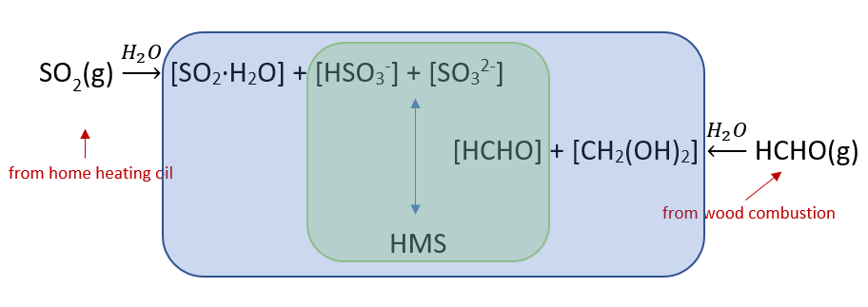
Why is there such disagreement in SO₄ Concentrations???
3
2) Quantitative measurements of SO₄ are unresolved
An organosulfur species, hydroxymethanesulfonate (HMS) forms during Alaskan winters.
Routine measurements of SO₄ likely include HMS concentrations.
HMS Formation
Notes:
Another potential reason behind the model-measurement discrepancies is the formation of an organosulfur species, hydroxymethanesulfonate, which I will be referring to from here-on-out as HMS. HMS is formed via aqueous phase reactions of formaldehyde, coming from wood combustion, and sulfur dioxide – which a major source during 2008 was from home heating oil. And you can imagine a lot of this is being formed not only because of the emissions of precursors, but also because it is cold enough for both precursors to partition and dissolve onto aqueous aerosols.
HMS is also often mistaken for sulfate in routine measurements, so, perhaps the observations that I showed before are not only sulfate but also HMS.

Slide 12
Why is there such disagreement in SO₄ Concentrations???
3
2) Quantitative measurements of SO₄ are unresolved
SO₄ + HMS = Sulfur Aerosol
An organosulfur species, hydroxymethanesulfonate (HMS) forms during Alaskan winters.
Routine measurements of SO₄ likely include HMS concentrations
HMS Formation
Notes:
And from here-on-out I will be referring to the combination of sulfate and HMS as sulfur aerosol.

Slide 13

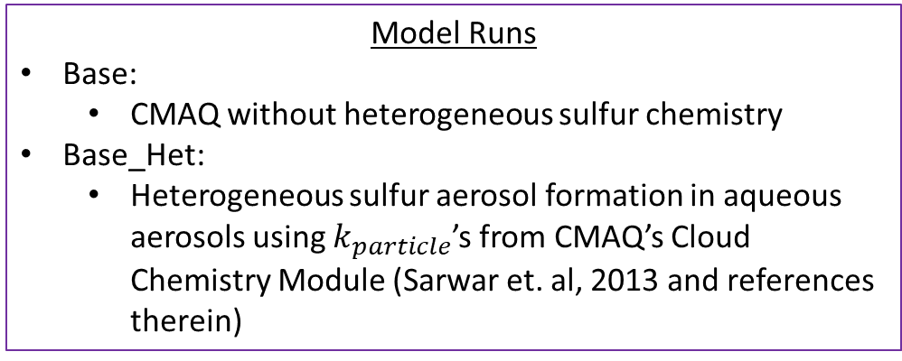
Implementation of aerosol-phase sulfur chemistry
4
Model Runs
Base:
  CMAQ without heterogeneous sulfur chemistry
Base_Het:
  Heterogeneous sulfur aerosol formation in aqueous aerosols using $k_{particle}$’s from CMAQ’s Cloud Chemistry Module (Sarwar et. al, 2013 and references therein)
Heterogeneous Chemistry Framework
SO₂(g)
SO₂(aq)
+
Oxidants(aq)
(i.e. O₃, H₂O₂, TMI-O₂, NO₂, HCHO)
$$k_{particle}$$
Sulfur Aerosol
Notes:
So we implemented this missing aqueous-aerosol phase chemistry in CMAQ and what I’m showing in this schematic is the general theme behind heterogeneous chemistry where you have gas phase sulfur dioxide partitioning onto and then reacting with oxidants and other reactants in an aqueous aerosol to form sulfur aerosol.
The reactions that take place in the aqueous phase are governed by the rate expression kparticle and there is one for each oxidation pathway, so one for O3, one for H2O2 so on and so forth.
And so we have a Base model run, which I showed the results for previously, and then the heterogeneous aqueous aerosol phase reactions are in our Base_Het run. And I just want to point out that the kparticles in this model run were sourced from the existing in-Cloud Chemistry Module detailed in Sarwar et al., 2013.

Slide 14
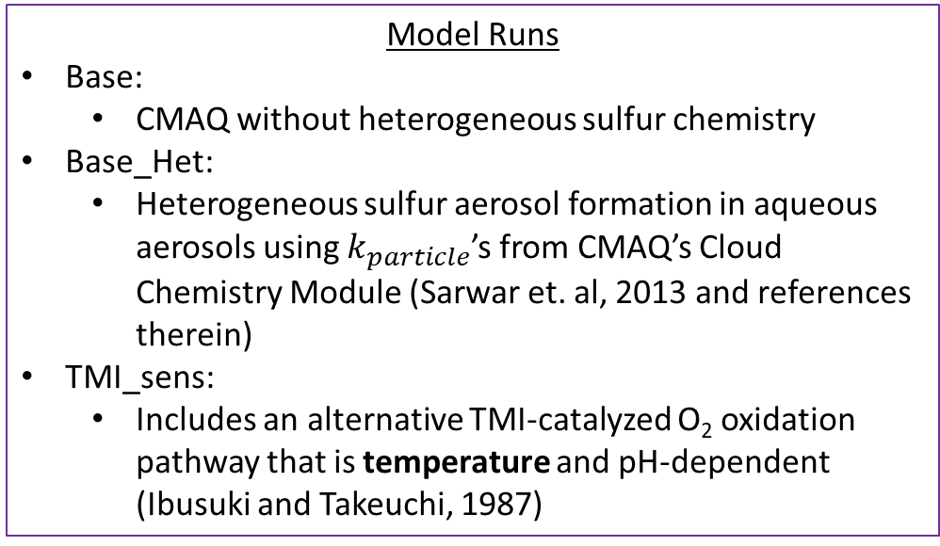
Implementation of aerosol-phase sulfur chemistry
4
Model Runs
Base:
  CMAQ without heterogeneous sulfur chemistry
Base_Het:
  Heterogeneous sulfur aerosol formation in aqueous aerosols using $k_{particle}$’s from CMAQ’s Cloud Chemistry Module (Sarwar et. al, 2013 and references therein)
TMI_sens:
  Includes an alternative TMI-catalyzed O₂ oxidation pathway that is temperature and pH-dependent (Ibusuki and Takeuchi, 1987)
Heterogeneous Chemistry Framework
SO₂(g)
SO₂(aq)
+
Oxidants(aq)
(i.e. O₃, H₂O₂, TMI-O₂, NO₂, HCHO)
$$k_{particle}$$
Transition Metal Ion: Fe³⁺/Mn²⁻
Sulfur Aerosol
Notes:
We then changed up the kparticles for some of the oxidation pathways in our sensitivity runs. In the first sensitivity run, we used an alternative kparticle for the TMI-catalyzed O2 oxidation pathway
and TMI is an acronym for transition metal ions, specifically iron and manganese. So this alternative kparticle for this pathway, unlike the one in the Base_Het, is both temperature and pH-dependent which is significant in this regions because the temperatures are really cold during these haze events and also the aerosol pH is not as acidic.

Slide 15
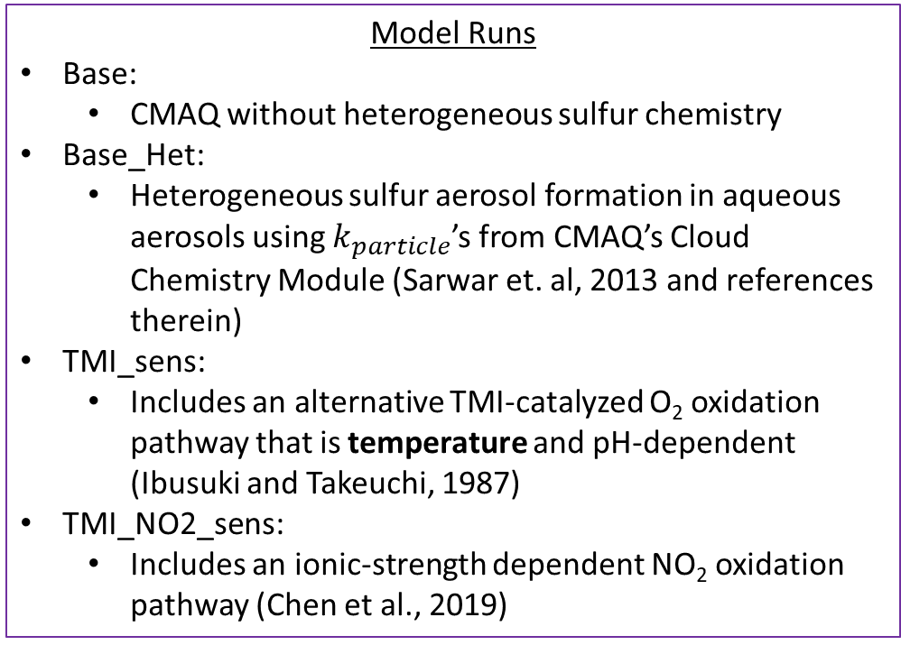
Implementation of aerosol-phase sulfur chemistry
4
Model Runs
Base:
  CMAQ without heterogeneous sulfur chemistry
Base_Het:
  Heterogeneous sulfur aerosol formation in aqueous aerosols using $k_{particle}$’s from CMAQ’s Cloud Chemistry Module (Sarwar et. al, 2013 and references therein)
TMI_sens:
  Includes an alternative TMI-catalyzed O₂ oxidation pathway that is temperature and pH-dependent (Ibusuki and Takeuchi, 1987)
TMI_NO2_sens:
  Includes an ionic-strength dependent NO₂ oxidation pathway (Chen et al., 2019)
Heterogeneous Chemistry Framework
SO₂(g)
SO₂(aq)
+
Oxidants(aq)
(i.e. O₃, H₂O₂, TMI-O₂, NO₂, HCHO)
$$k_{particle}$$
Transition Metal Ion: Fe³⁺/Mn²⁻
Sulfur Aerosol
Notes:
In our second sensitivity run we implement an ionic strength-dependent NO2 oxidation pathway

Slide 16
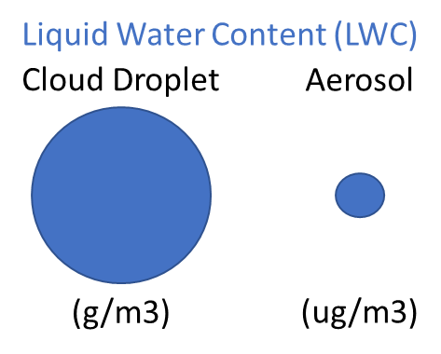
Implementation of aerosol-phase sulfur chemistry
4
Model Runs
Base:
  CMAQ without heterogeneous sulfur chemistry
Base_Het:
  Heterogeneous sulfur aerosol formation in aqueous aerosols using $k_{particle}$’s from CMAQ’s Cloud Chemistry Module (Sarwar et. al, 2013 and references therein)
TMI_sens:
  Includes an alternative TMI-catalyzed O₂ oxidation pathway that is temperature and pH-dependent (Ibusuki and Takeuchi, 1987)
TMI_NO2_sens:
  Includes an ionic-strength dependent NO₂ oxidation pathway (Chen et al., 2019)
Heterogeneous Chemistry Framework
SO₂(g)
SO₂(aq)
+
Oxidants(aq)
(i.e. O₃, H₂O₂, TMI-O₂, NO₂, HCHO)
$$k_{particle}$$
Transition Metal Ion: Fe³⁺/Mn²⁻
Sulfur Aerosol
Cloud -> Aerosol Implications
g/m³
µg/m³
Ionic Strength (I)
Notes:
And ionic strength is an important parameter to track when going from in-cloud phase oxidation to aerosol oxidation because the water content in an aerosol is much lower than that in a cloud droplet. So the ionic strength can be higher in aerosols and this ionic strength can either inhibit the kparticle (which is the case for the TMI oxidation pathway) or enhance the kparticle (which is the case for the NO2 oxidation pathway).

Slide 17
Implementation of aerosol-phase sulfur chemistry
4
Model Runs
Base:
  CMAQ without heterogeneous sulfur chemistry
Base_Het:
  Heterogeneous sulfur aerosol formation in aqueous aerosols using $k_{particle}$’s from CMAQ’s Cloud Chemistry Module (Sarwar et. al, 2013 and references therein)
TMI_sens:
  Includes an alternative TMI-catalyzed O₂ oxidation pathway that is temperature and pH-dependent (Ibusuki and Takeuchi, 1987)
TMI_NO2_sens:
  Includes an ionic-strength dependent NO₂ oxidation pathway (Chen et al., 2019)
Heterogeneous Chemistry Framework
SO₂(g)
SO₂(aq)
+
Oxidants(aq)
(i.e. O₃, H₂O₂, TMI-O₂, NO₂, HCHO)
$$k_{particle}$$
Transition Metal Ion: Fe³⁺/Mn²⁻
Sulfur Aerosol
Cloud -> Aerosol Implications
Additional cloud chemistry pathways were included in new model runs for oxidation by NO₂, OH, HNO₄, and NO₃ along with in-cloud production and loss of HMS.
g/m³
µg/m³
Ionic Strength (I)
Notes:
Lastly – some new in-cloud phase oxidation pathways were included in all new model runs, so the Base_Het and the sensitivities.

Slide 18

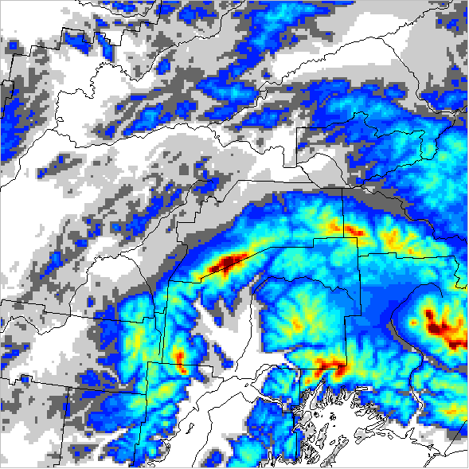


Modeling Domain and Episodes
5
AK Domain
Ep 1: Jan 25 – Feb 10, 2008 | Ep 2: Nov 4-17, 2008
Spatial Domain: 199x199 domain with 1.33 km cell resolution, lowest layer ~4m
Elevation Map of AK Domain
Cold and Dark
More Fog Events
Fairbanks
Ground height above sea level (m)
1.33 km Domain
N. Hemi Domain
Dec 2015 – Feb 2016
Spatial Domain: N. Hemisphere, 108 km cell resolution
4 km Domain
Notes:
I will be showing modeled sulfate results from two domains, the Fairbanks/North Pole Domain – which has a fine spatial resolution of 1.33km is illustrated in the map to the right and then we also did some CMAQ-hemispheric runs for Dec 2015 to Feb 2016
We model two episodes in the Fairbanks/North Pole Domain, one during Jan/Feb of 2008 when it is very cold and dark and then an episode in November 2008 where it is less cold and dark but where there are a lot more fog events – and where we expect to see sulfur aerosol forming in both aqueous aerosols and cloud droplets at the surface – and I will be reminding you of these episodes via these pictures.

Slide 19
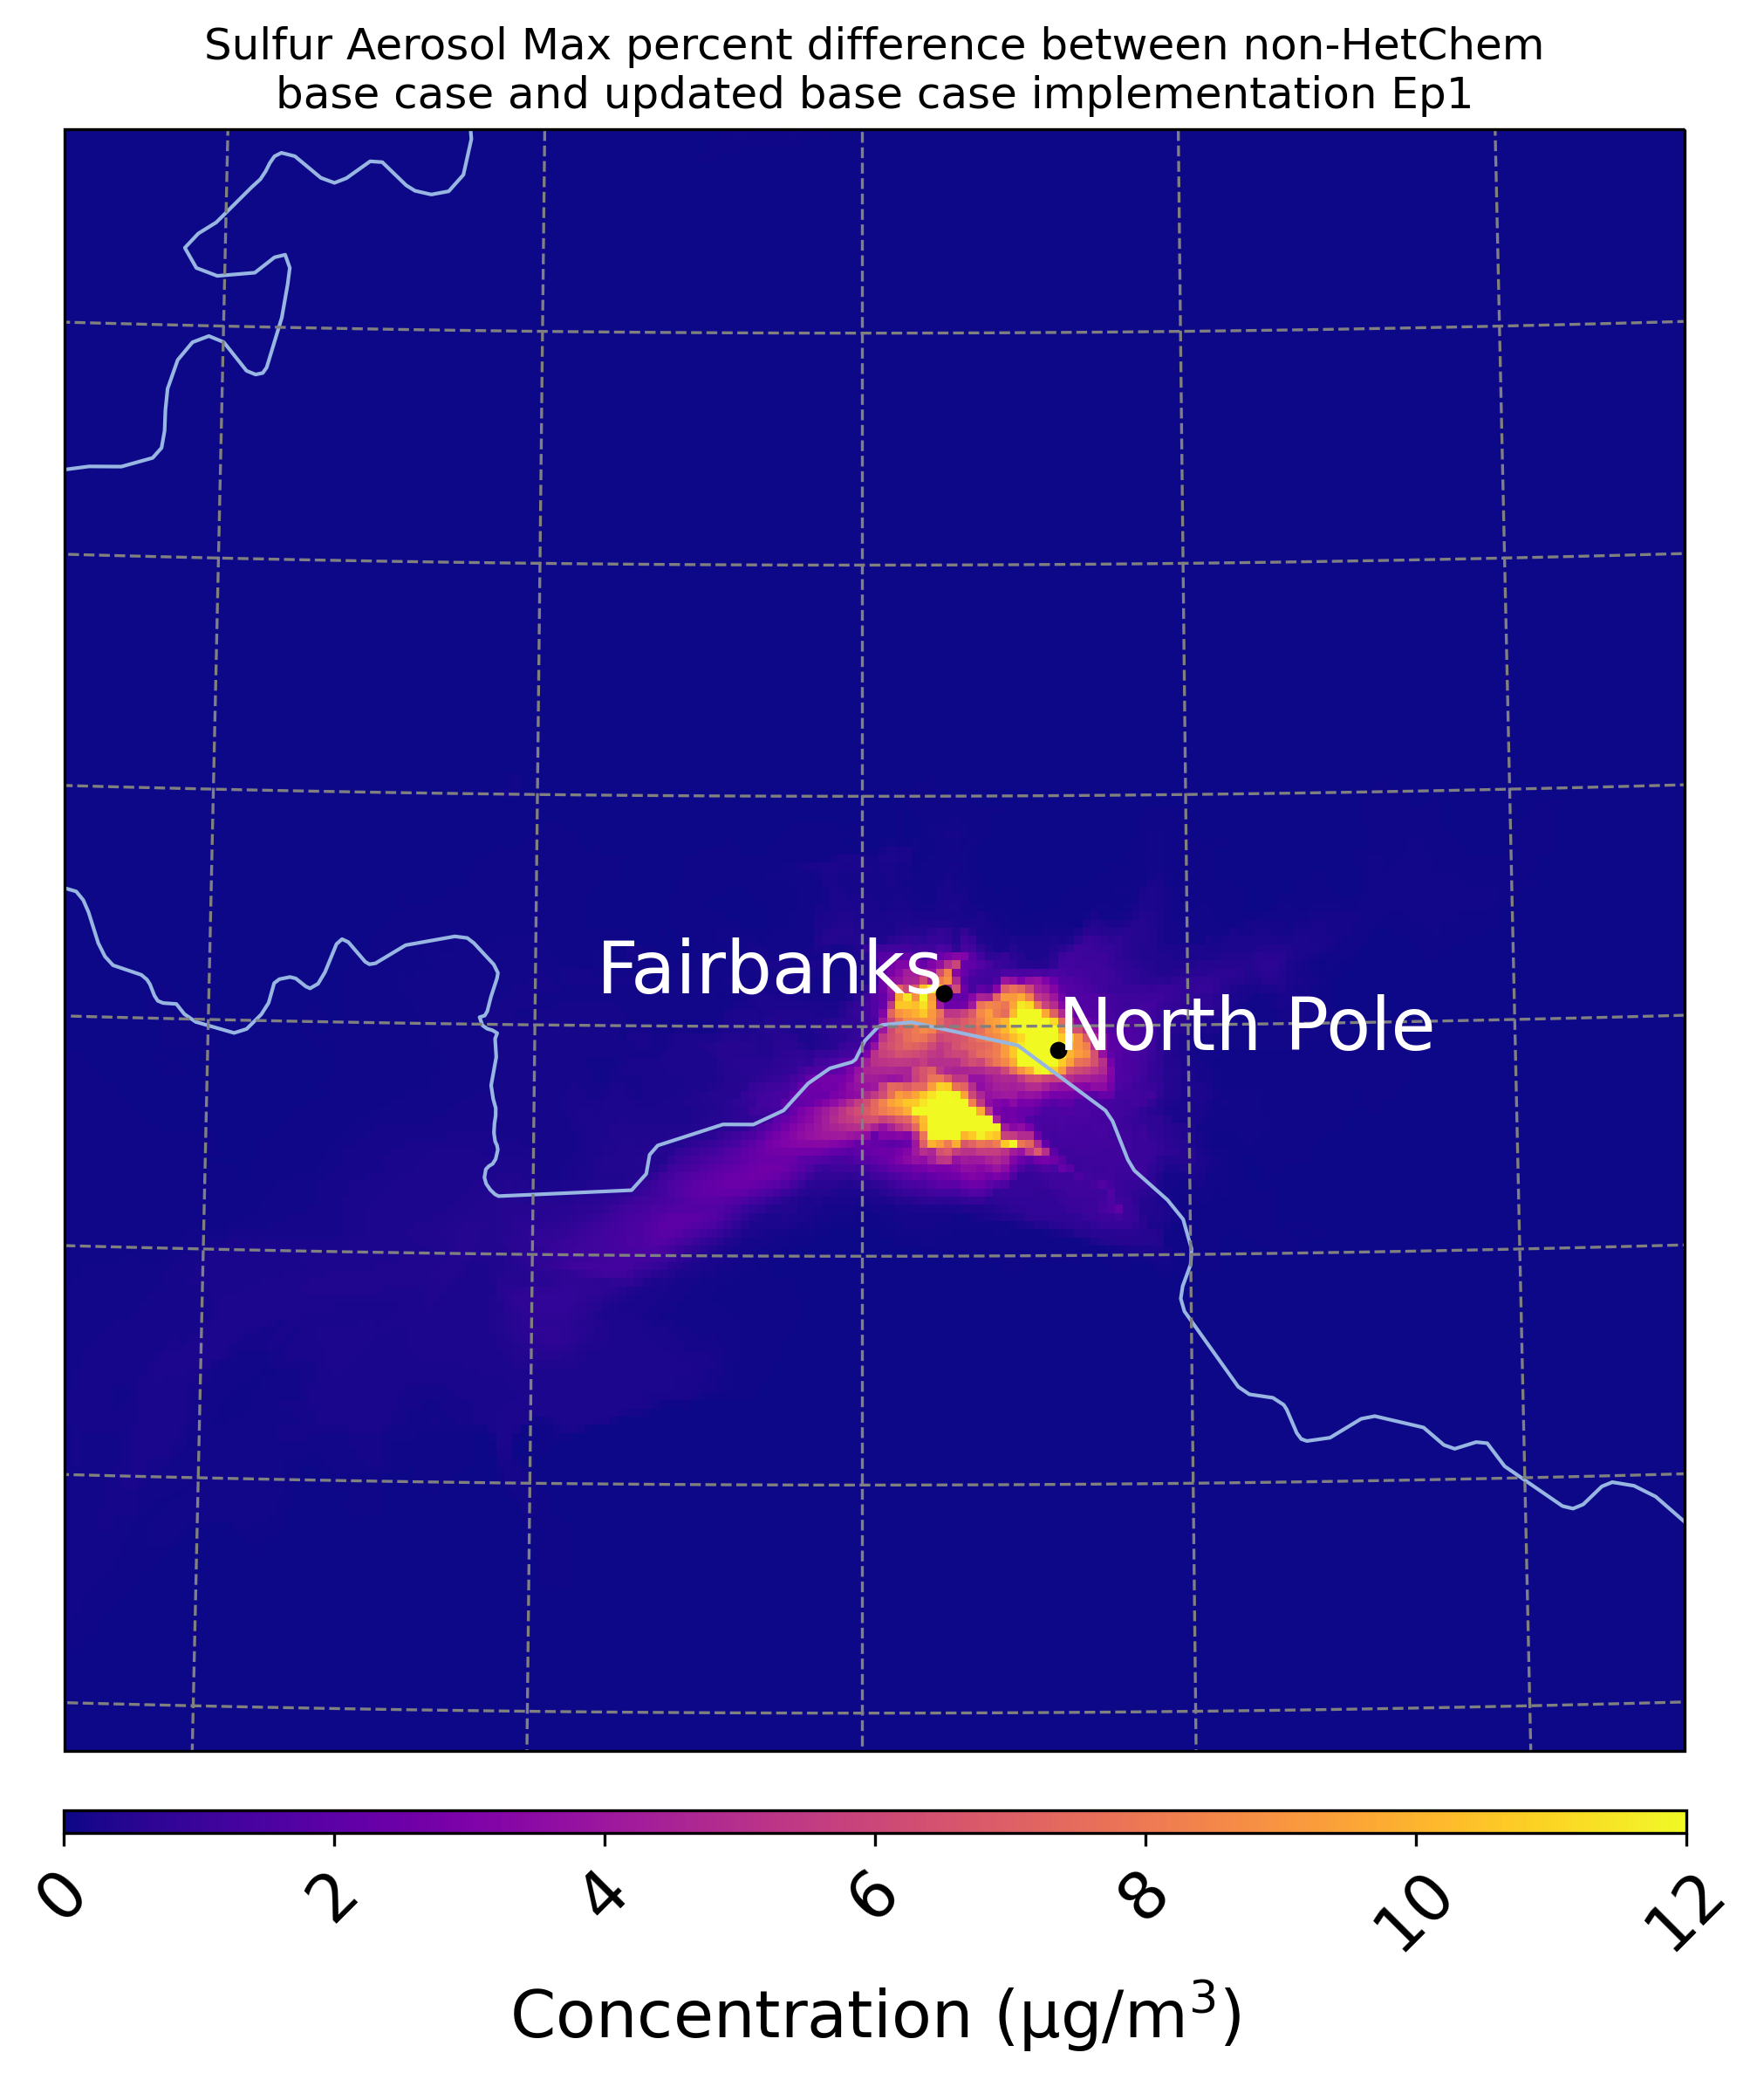
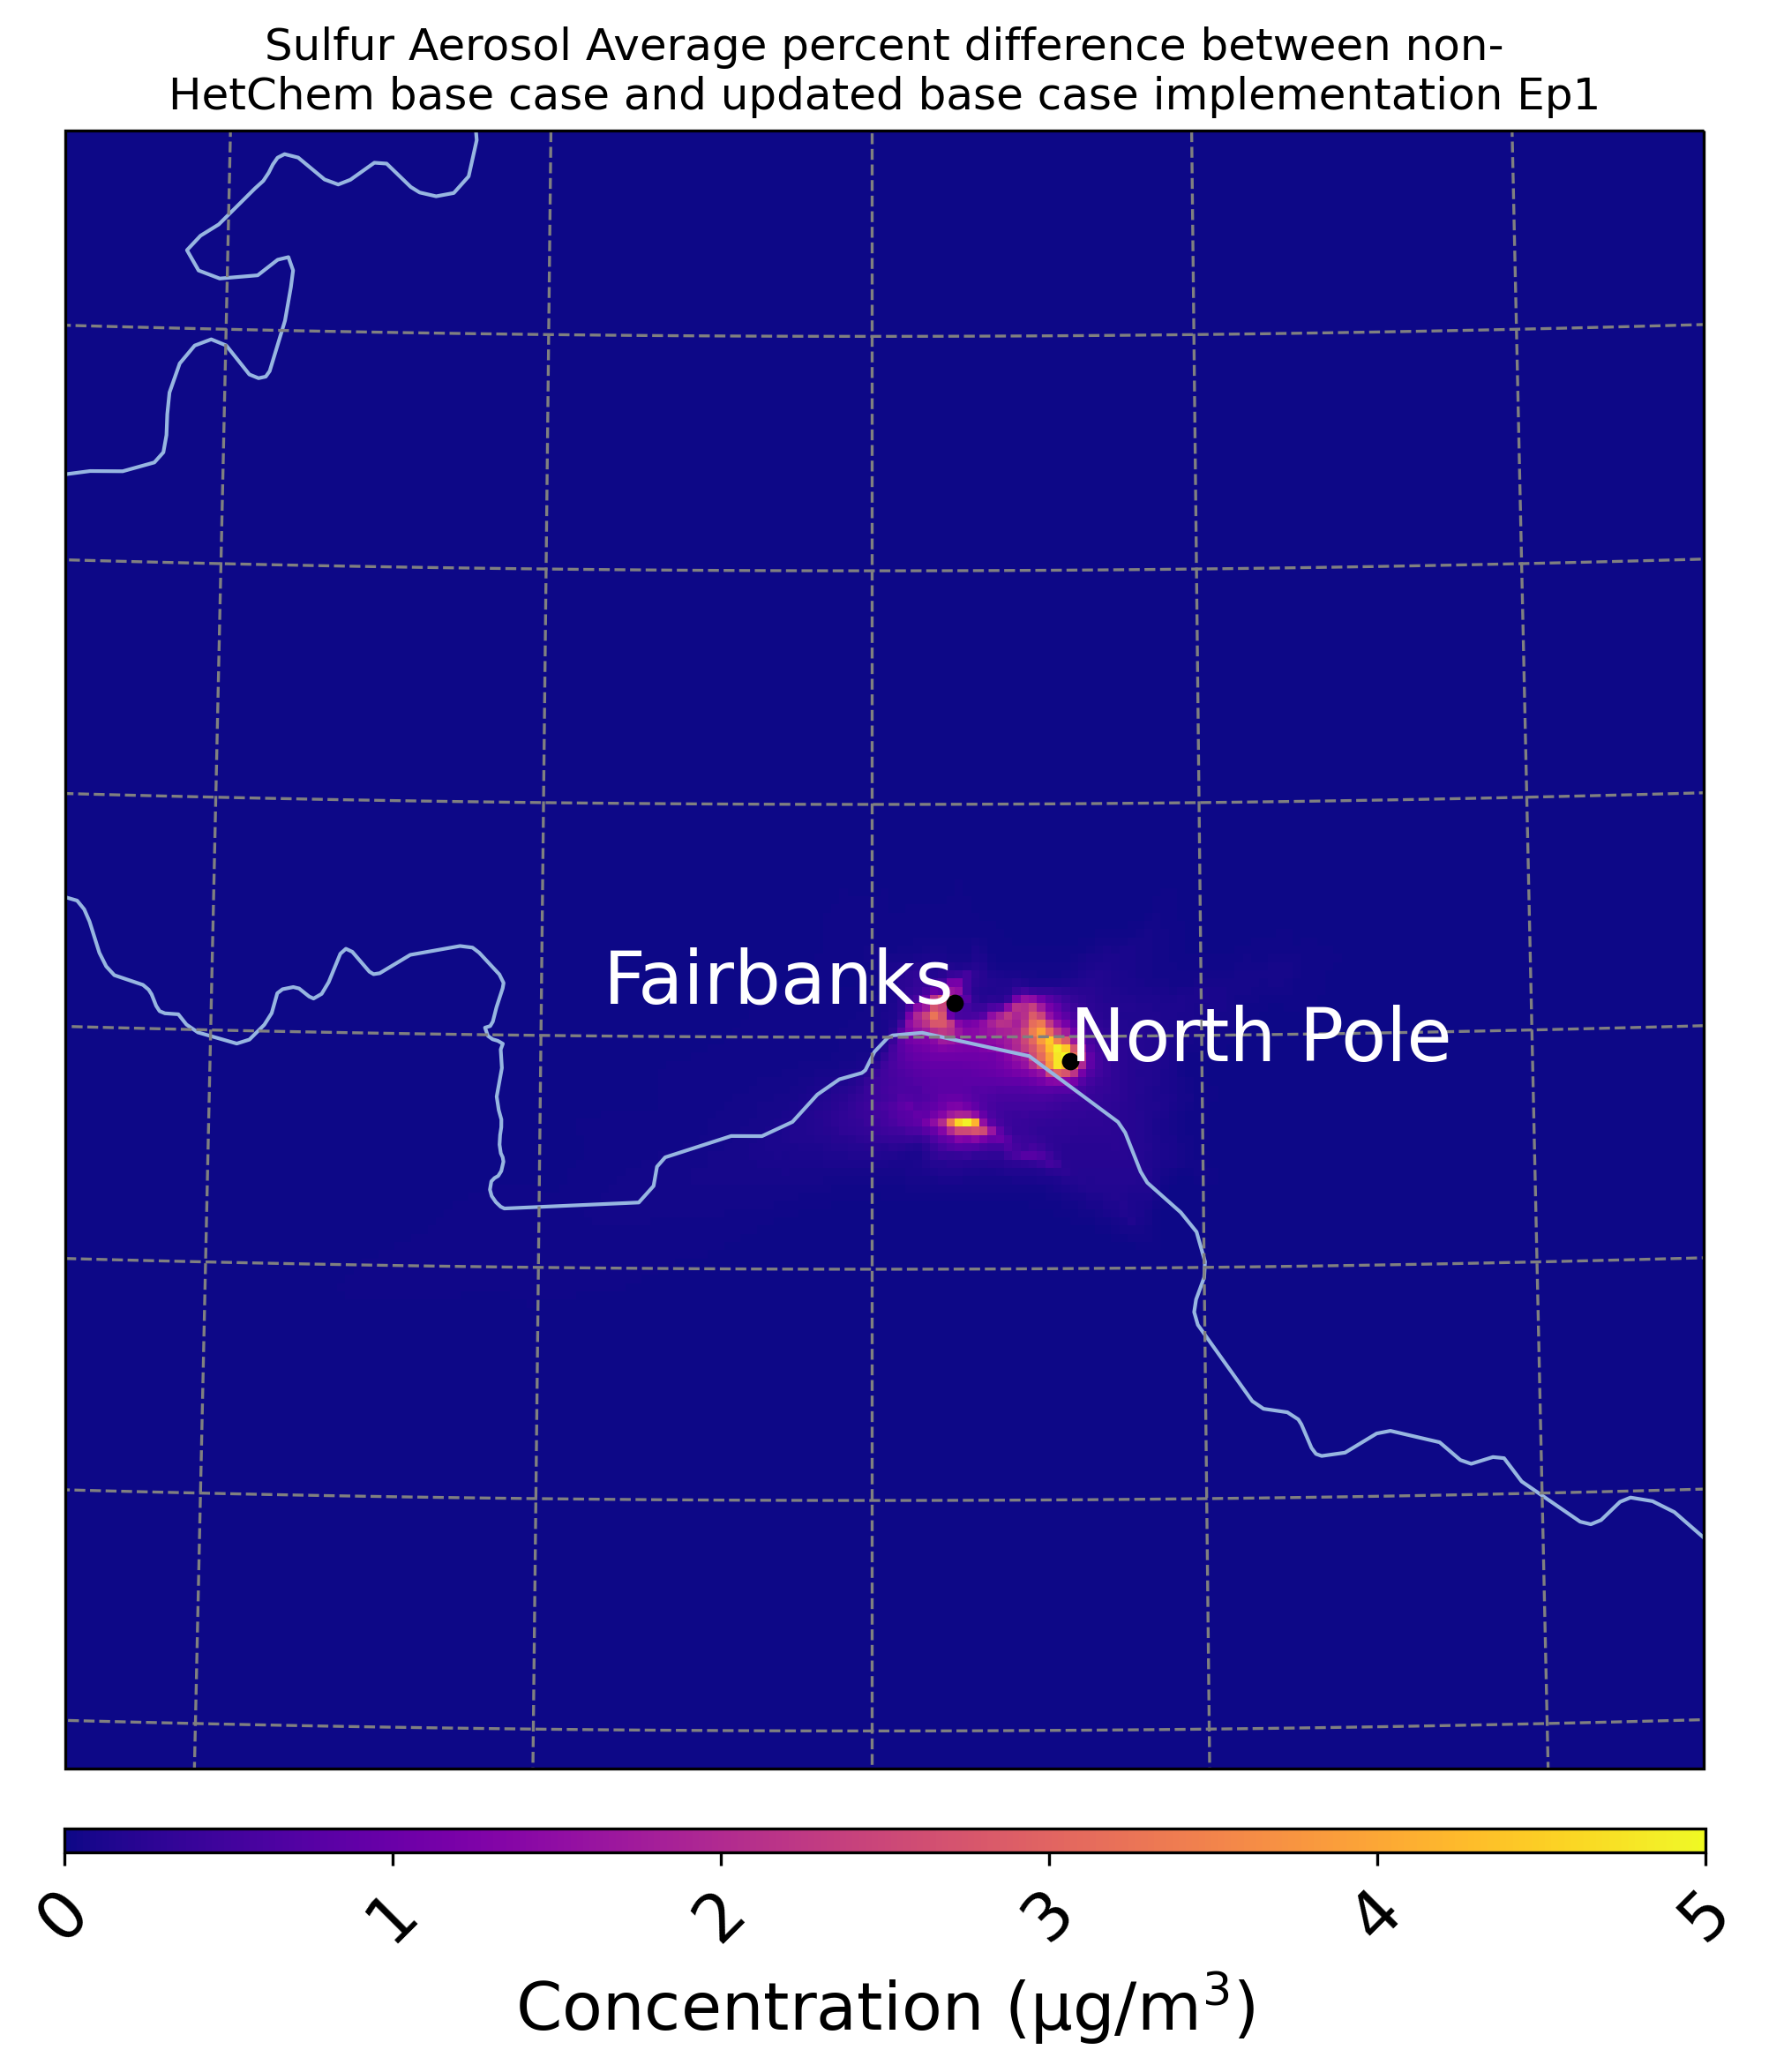
Sulfur Aerosol Enhancement with Base Heterogeneous Sulfur Chemistry (Base_Het)
6
Sulfur Aerosol increases in the Alaska Domain with the implementation of heterogeneous sulfur chemistry in the Base_Het run.
Ep 1 (Jan 25th – Feb 11th)
Max Hourly Increase:
Base_Het - Base
Average Hourly Increase:
Base_Het - Base
Notes:
With the implementation of heterogeneous sulfur chemistry in the Base_Het run, we see large enhancements in modeled sulfur aerosols during this cold and dark episode and what I’m showing in these spatial plots are Max and Average hourly increases from the Base run. You can see on average that modeled sulfur aerosol increases in Fairbanks around 3.5 ug/m3 and 5ug/m3 in North Pole and then these increases can be up to 12ug/m3 in both cities.

Slide 20
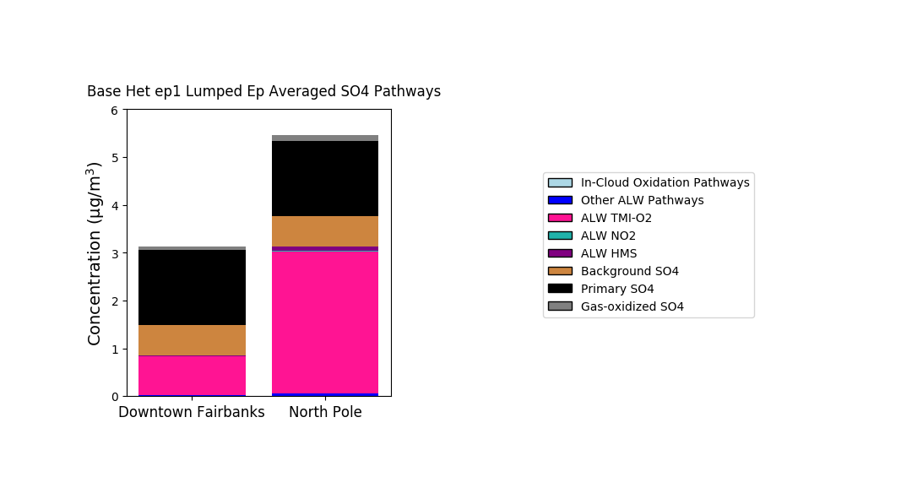


Sulfur Aerosol Enhancement with Base Heterogeneous Sulfur Chemistry (Base_Het)
6
Sulfur Aerosol increases in the Alaska Domain with the implementation of heterogeneous sulfur chemistry in the Base_Het run.
Ep 1 (Jan 25th – Feb 11th)
CMAQ Sulfur Aerosol Speciation
Max Hourly Increase:
Base_Het - Base
Average Hourly Increase:
Base_Het - Base
Base_Het
Heterogeneous sulfur aerosol formation dominated by the TMI-catalyzed O₂ oxidation pathway
Notes:
We then wanted to see if these increases were coming from our newly implemented heterogeneous pathways and you can see from the stacked bar chart to the right that secondarily produced sulfur aerosol is mostly sulfate being formed from the TMI-catalyzed pathway. I should also point out that the aqueous-aerosol heterogeneous pathways are denoted by ALW – which stands for aerosol liquid water.
I also want to go ahead and point out that Fairbanks and North Pole are distinct in emissions profiles. Fairbanks has a more industrial and traffic-related emissions profile while most of the PM2.5 in North Pole is derived from home heating emissions as it’s more residential than urban.

Slide 21
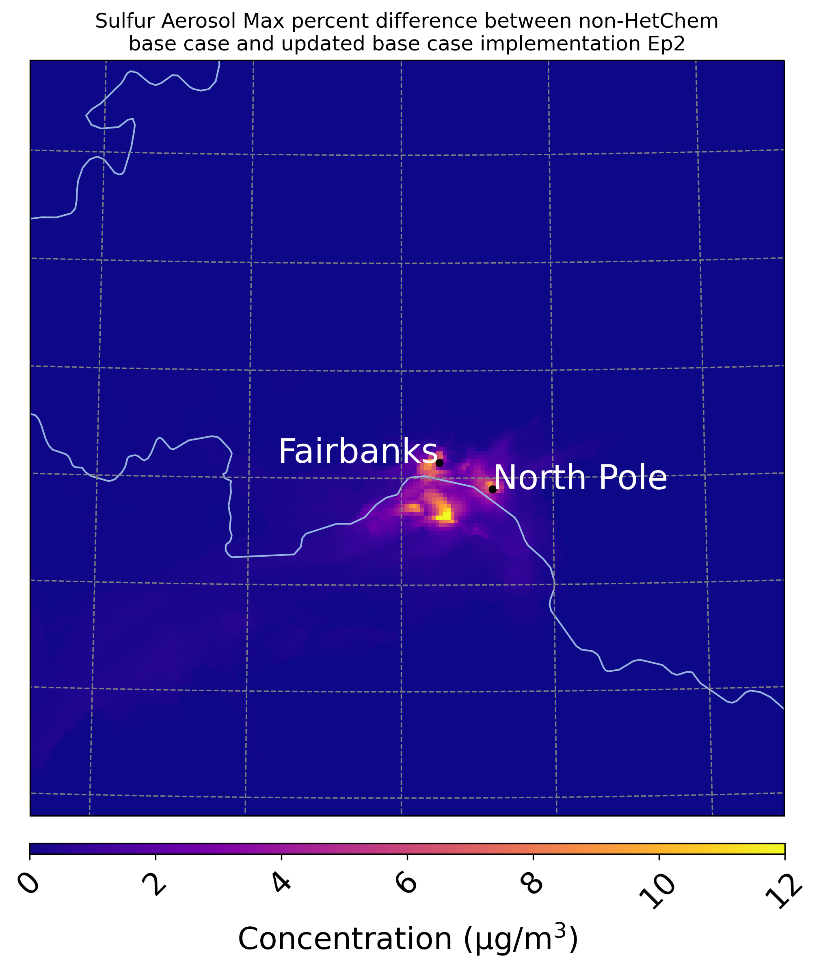
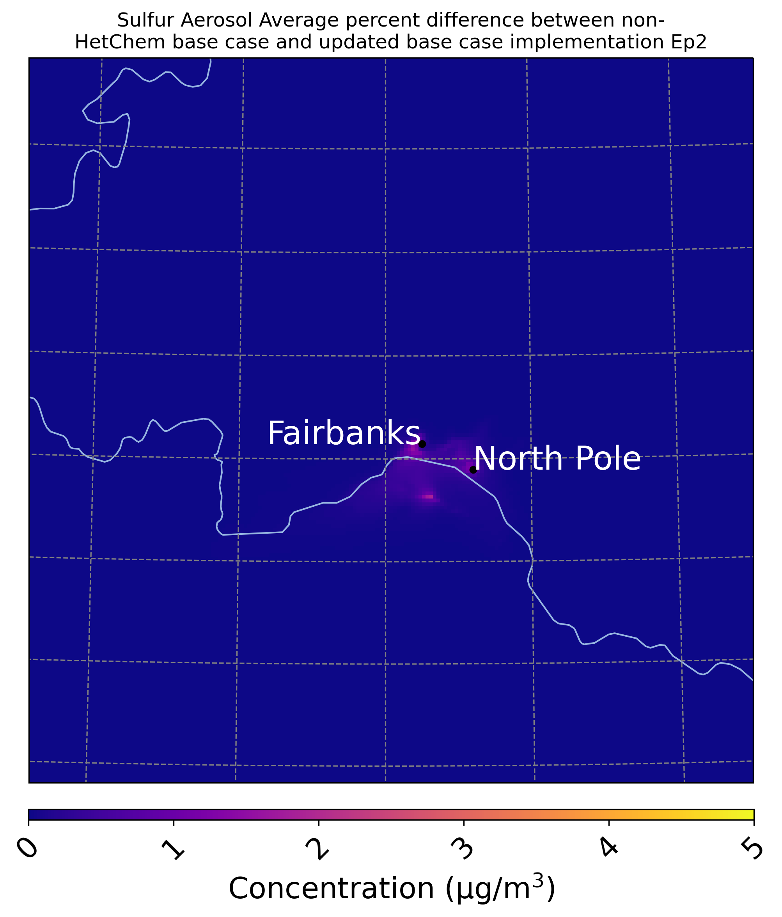
Sulfur Aerosol Enhancement with Base Heterogeneous Sulfur Chemistry (Base_Het)
7
Ep 1 (Jan 25th – Feb 11th)
Ep 2 (Nov 4th – Nov 17th)
Max Hourly Increase:
Base_Het - Base
Average Hourly Increase:
Base_Het - Base
Max Hourly Increase:
Base_Het - Base
Average Hourly Increase:
Base_Het - Base
Notes:
Hourly Sulfur aerosol enhancements during episode 2 can get up to 12 ug/m3 but

Slide 22
Sulfur Aerosol Enhancement with Base Heterogeneous Sulfur Chemistry (Base_Het)
7
Ep 1 (Jan 25th – Feb 11th)
Ep 2 (Nov 4th – Nov 17th)
Max Hourly Increase:
Base_Het - Base
Average Hourly Increase:
Base_Het - Base
Max Hourly Increase:
Base_Het - Base
Average Hourly Increase:
Base_Het - Base
Enhancements in sulfur aerosol concentrations are greater during Ep1 (when it is colder and darker)
Notes:
on average enhancements in sulfur aerosol concentrations are greater during episode 1 showing how important these cold and dark conditions are to it’s formation.

Slide 23
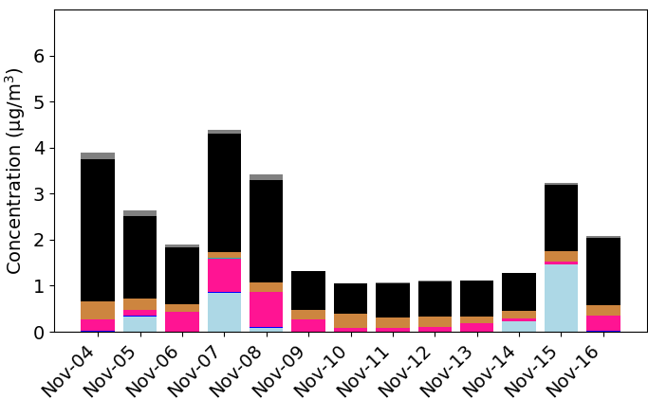
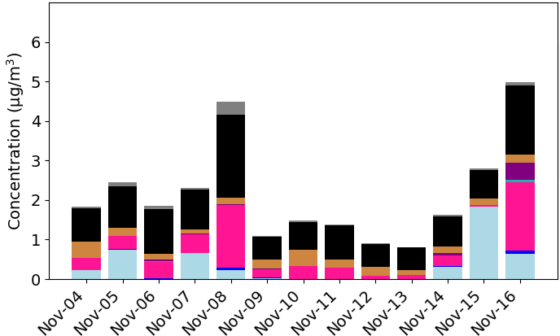
Sulfur Aerosol Enhancement with Base Heterogeneous Sulfur Chemistry (Base_Het)
8
CMAQ Sulfur Aerosol Speciation
Ep 2 (Nov 4th – Nov 17th)
Downtown Fairbanks
Max Hourly Increase:
Base_Het - Base
Average Hourly Increase:
Base_Het - Base
Capturing fog/cloud events!
North Pole
Notes:
But one thing that is also notable is that in episode 2 we are seeing some sulfur aerosol being formed at the surface from in-cloud oxidation, showing that the model is picking up on these fog events. So the WRF modeling that Rob Gilliam did for this work is capturing these fog events and the CMAQ’s in-cloud chemistry module is picking up on it!

Slide 24
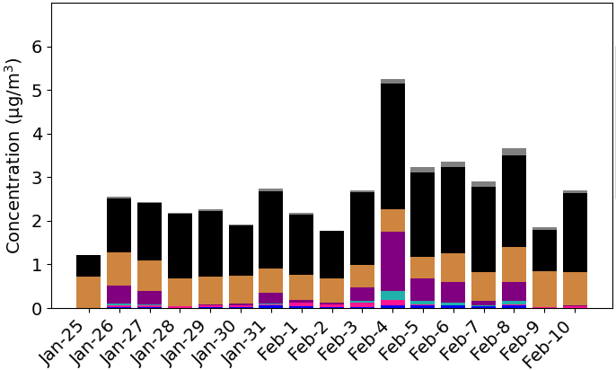
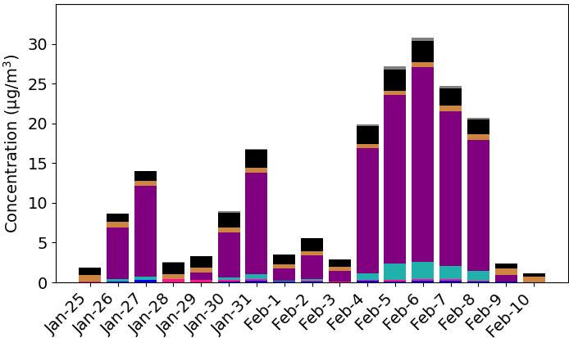
HMS Enhancement with Alternative TMI-catalyzed O₂ oxidation pathway (TMI_sens)
Ep 1 (Jan 25th – Feb 11th)
9
CMAQ Sulfur Aerosol Speciation
Downtown Fairbanks
North Pole
Notes:
Switching back to episode one, when we implemented the temperature and pH dependent alternative kparticle for the TMI-catalyzed O2 pathway in the TMI_sens sensitivity run, we saw that most of the secondarily produced sulfur aerosol was HMS and not from the TMI-pathway – which was consuming almost all of the sulfur dioxide in the Base_Het run
And why is that?

Slide 25
HMS Enhancement with Alternative TMI-catalyzed O₂ oxidation pathway (TMI_sens)
Ep 1 (Jan 25th – Feb 11th)
9
CMAQ Sulfur Aerosol Speciation
Downtown Fairbanks
North Pole
TMI-catalyzed O₂ oxidation pathway is limited due to decreased temperatures in this sensitivity run (TMI_sens)
Notes:
Well this alternative rate expression is slowed down by decreased temperatures. And so all of that SO2 is now freed up to react with other oxidants and reactants and it’s reactant of choice in this model run is formaldehyde. And a lot more HMS is produced in North Pole than Fairbanks!

Slide 26
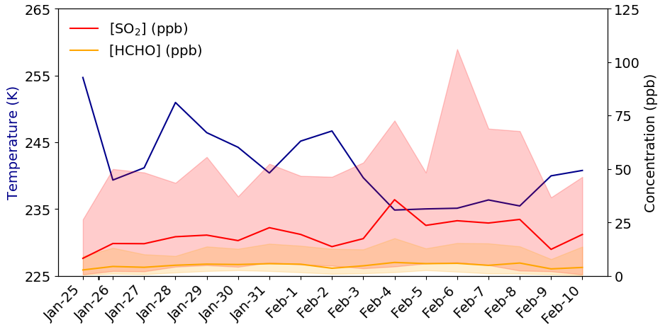
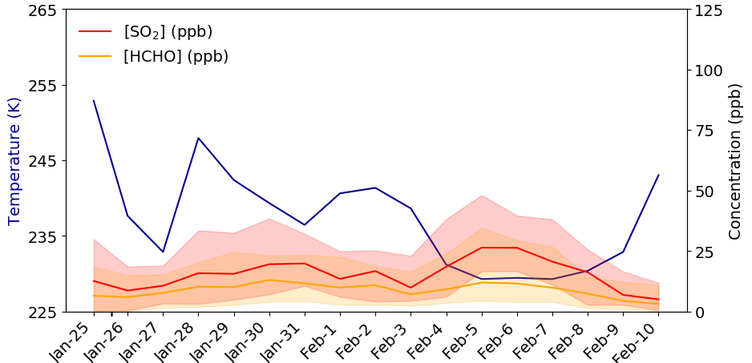
HMS Enhancement with Alternative TMI-catalyzed O₂ oxidation pathway (TMI_sens)
Ep 1 (Jan 25th – Feb 11th)
9
CMAQ Sulfur Aerosol Speciation
Downtown Fairbanks
North Pole
TMI-catalyzed O₂ oxidation pathway is limited due to decreased temperatures in this sensitivity run (TMI_sens)
Notes:
So lets dive a little bit more into what is contributing to this abundance of modeled HMS. What I have plotted below each site’s sulfur aerosol speciation plots are daily average max and min concentrations of sulfur dioxide and formaldehyde in ppb and then daily average temperatures in blue. We see that although sulfur dioxide concentrations are higher in Fairbanks than North Pole, however 1) temperatures are colder in North Pole and 2) there is more formaldehyde there as well.

Slide 27
HMS Enhancement with Alternative TMI-catalyzed O₂ oxidation pathway (TMI_sens)
Ep 1 (Jan 25th – Feb 11th)
9
CMAQ Sulfur Aerosol Speciation
Downtown Fairbanks
North Pole
TMI-catalyzed O₂ oxidation pathway is limited due to decreased temperatures in this sensitivity run (TMI_sens)
SO₂ then favors reacting with HCHO to form HMS in this sensitivity run – especially at temperatures < 245 K
Notes:
And on the days where HMS skyrockets in North Pole, the temperature is below 235K – so more there is more formaldehyde, and although it is one of the more volatile organics, more is dissolving and reacting with SO2 in aqueous aerosols.
when going from the effective H-law at 273K to 233K the H-law coeff decreases by ~90%

Slide 28
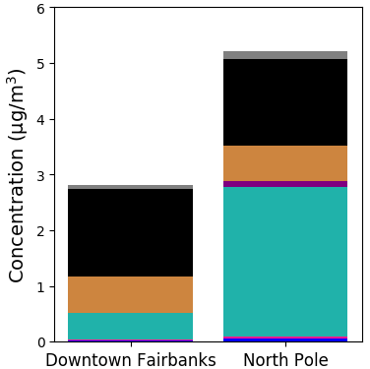
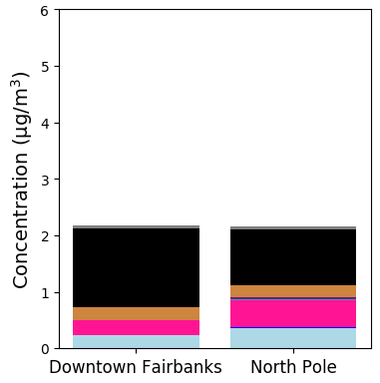
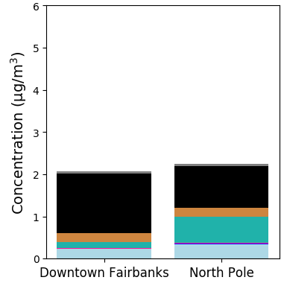
Results from an ionic-strength dependent NO2 oxidation pathway (TMI_NO2_sens)
10
CMAQ Sulfur Aerosol Speciation
Ep 1 (Jan 25th – Feb 11th)
Ep 2 (Nov 4th – Nov 11th)
Base_Het
TMI_NO2_sens
The Base_Het run and the TMI_NO2_sens run are similar in total secondary sulfur aerosol concentrations.
The TMI_NO2_sens run enhances sulfate concentrations from the heterogeneous NO₂ oxidation pathway.
Notes:
In our last sensitivity model run we implemented an ionic-strength dependent NO2 oxidation pathway in the heterogeneous sulfur chemistry framework on top of the alternative TMI pathway. And this new NO2 pathways has one of the most aggressive rates of formation.
We see that in both episodes, total sulfur aerosol between this sensitivity and the Base_Het case are pretty similar, however the pathway that produces the majority of secondary sulfur aerosol is the NO2 pathway, which is also out-competing HMS formation. We still don’t know which pathway is actually more important in this region however and so we are hopeful to find out more on sulfur aerosol formation pathways from the recent ALPACA field campaign that took place in the Fairbanks/North Pole region this past winter.
rate constant = 2e6 (no temperature dependence)
kparticle = [NO2]*rate constant.

Slide 29
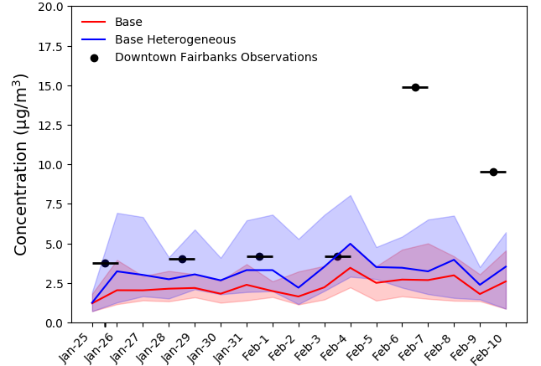
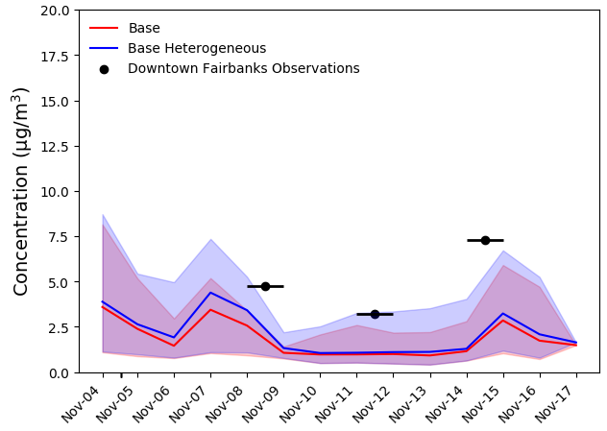
Alaska Domain Sulfur Aerosol Model Performance in Downtown Fairbanks
11
Ep 1 (Jan 25th – Feb 11th)
Ep 2 (Nov 4th – Nov 11th)
Notes:
Overall for both episodes in Alaska, the incorporation of heterogeneous sulfur chemistry is bringing the model closer to sulfur aerosol concentrations for both episodes.

Slide 30
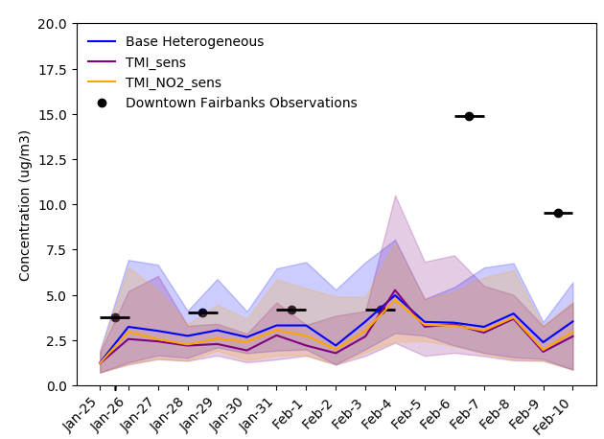
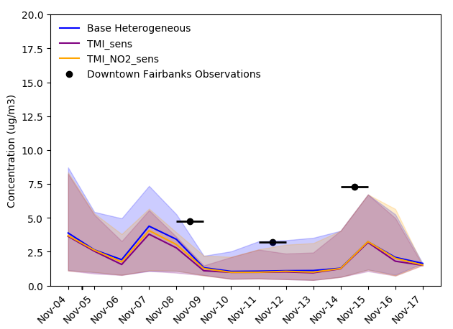
Alaska Domain Sulfur Aerosol Model Performance in Downtown Fairbanks
12
Ep 1 (Jan 25th – Feb 11th)
Ep 2 (Nov 4th – Nov 11th)
Notes:
And then sulfur aerosol produced in our sensitivity runs is a little bit less than in the Base_Het run.

Slide 31
Alaska Domain Sulfur Aerosol Model Performance in Downtown Fairbanks
13
Ep 1 (Jan 25th – Feb 11th)
Ep 2 (Nov 4th – Nov 11th)
Only 1 monitor active during these episodes in 2008 in Downtown Fairbanks
Notes:
But we are only comparing to 1 monitor in the domain, and that monitor is in Downtown Fairbanks, so we are not able to assess the performance in North Pole where we saw much higher HMS being produced by the model in the TMI_sens run.

Slide 32
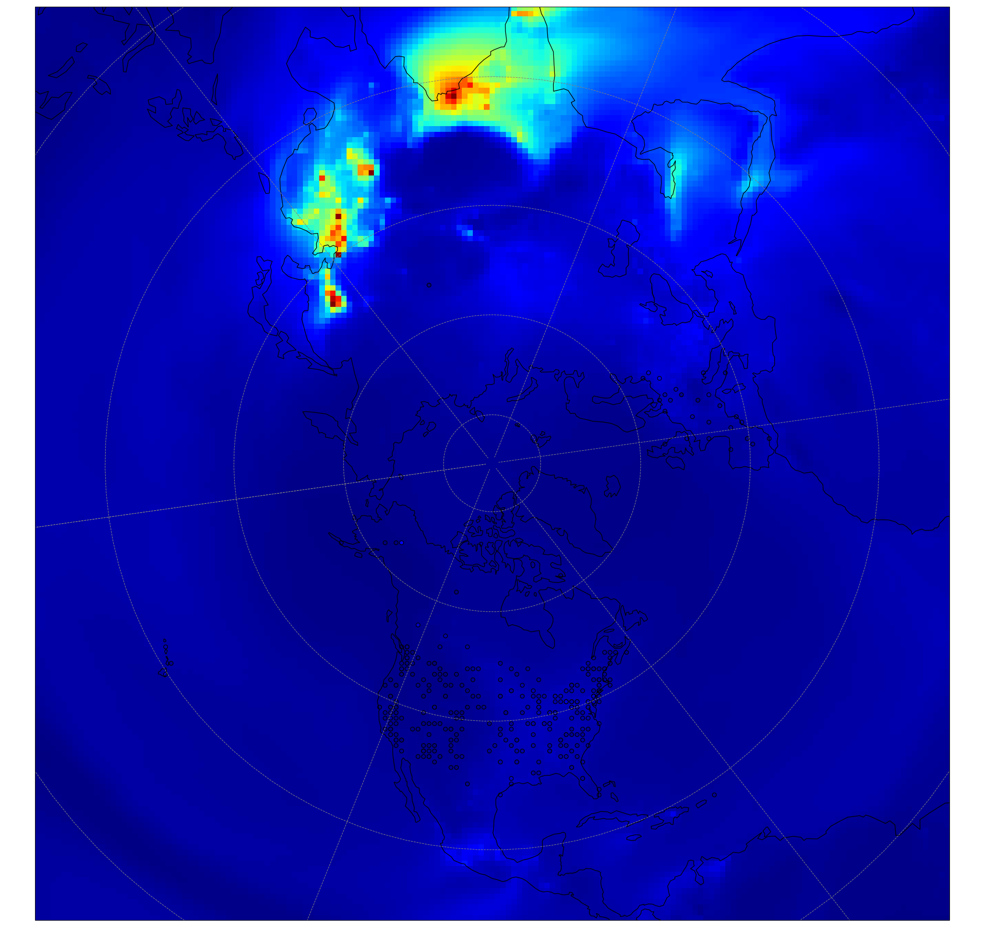
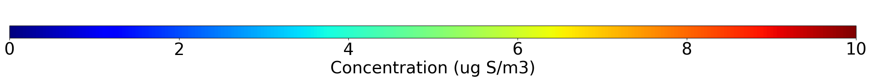
CMAQ-Hemispheric (Northern Hemisphere) Model Performance
14
Base_Het
Average Sulfur Aerosol Concentrations (Dec 2015 – Feb 2016)
Notes:
So we also did a Hemispheric run to compare our modeling runs to more observations. What I’m showing to the left are average sulfur aerosol concentrations produced from the Base_Het run overlayed by observed averages for this time period and there is pretty good agreement on average.

Slide 33
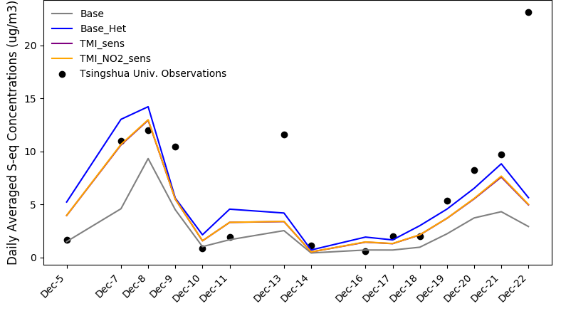
CMAQ-Hemispheric (Northern Hemisphere) Model Performance
14
Base_Het
Model-Measurement Tsinghua University, Beijing
Observational data from Zhang et al., 2021
Average Sulfur Aerosol Concentrations (Dec 2015 – Feb 2016)
Notes:
And then we compared CMAQ model output from our runs to observations from Tsinghua University published in Zhang et al., 2021. Tsinghua University is in Beijing, where they also experience winter-time haze events

Slide 34
CMAQ-Hemispheric (Northern Hemisphere) Model Performance
14
Base_Het
Model-Measurement Tsinghua University, Beijing
Observational data from Zhang et al., 2021
The additional sulfur chemistry reduces model-observation differences for a heavily polluted winter period at Tsinghua University
Average Sulfur Aerosol Concentrations (Dec 2015 – Feb 2016)
Notes:
And see that the incorporation of heterogeneous sulfur aerosol even helps the hemispheric model catch up to heightened observed sulfur aerosol concentrations.
*We don’t see the sensitivities outcompete the base, similar to what we saw in the Alaska Domain, and there was also little HMS formation in this grid cell but larger enhancements in regions surrounding it so unlike what we see in the Alaska Domain, most of what I am showing modeled is sulfate and while we didn’t have the sulfur tracking method turned on for those model runs, I would guess that sulfu*…..

Slide 35
Conclusions and Next Steps
15
The inclusion of heterogeneous sulfur chemistry enhances wintertime sulfur aerosol in Alaska and the Northern Hemisphere.
Fine-scale modeling indicates the potential for significant localized HMS production.
Sensitivity simulations change the importance of the inferred sulfur aerosol formation pathways but not the total sulfur aerosol formation.
The ALPACA field campaign (Jan – Feb 2022 in Fairbanks) will provide chemical constraints to help determine which sulfur aerosol formation pathways are most important.

Slide 36
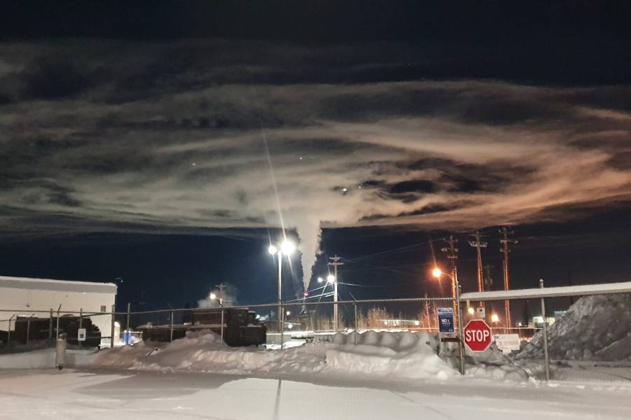
Thank you! Questions?
Photo: Dr. BRICE TEMIME-ROUSSEL (AMU)
Contact Info:
Sara Farrell (slfarrel@live.unc.edu) Kathleen Fahey (Fahey.Kathleen@epa.gov)
Notes:
COURTESY OF BRICE TEMIME-ROUSSEL

